Slide 1
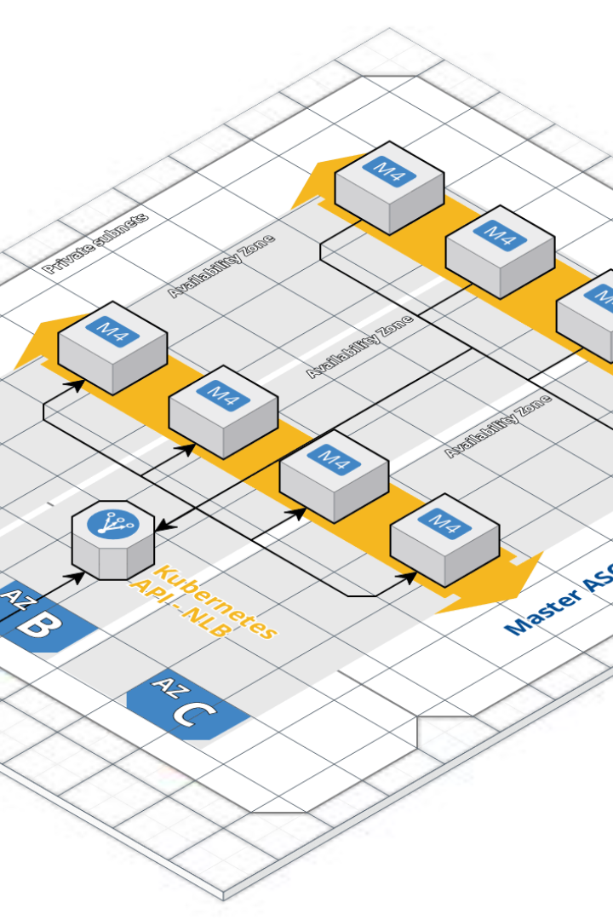

Welcome to AWS Training Course
Over the next few days, we will cover a lot of ground in AWS, including IAM, EC2, EBS, S3, RDS, and Lambda. You'll learn how to create instances, buckets, and databases, use the AWS CLI, and configure security groups.
V
by Vidyasagar VB

Slide 2
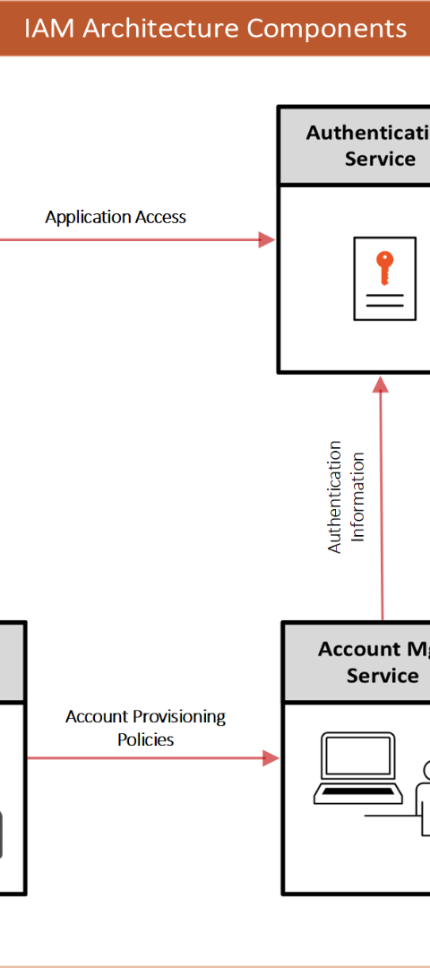
IAM and MFA
1
Identity and Access Management
IAM allows you to manage users and their access to AWS resources.
2
Multi-Factor Authentication
MFA provides an extra layer of security to protect your AWS account.

Slide 3
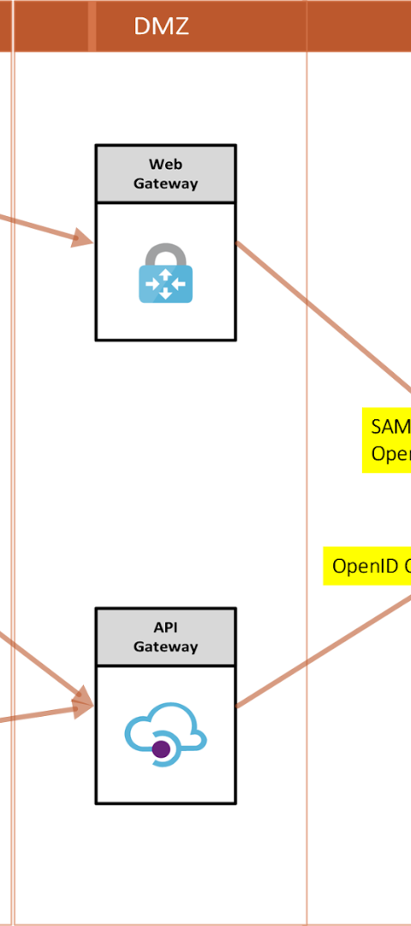
Creating IAM Users and Groups
Creating IAM Users
To create an IAM user, follow a few simple steps. Go to the IAM console, click on "Users", "Add User" and enter a name for the user. Select an access type, set permissions policies, go to "Security Credentials" and create an access key. Finally, configure the AWS CLI using the command prompt.
Creating Groups
To create groups, simply give the command "aws iam create-group --group-name".

Slide 4
Introduction to EC2
Go to the EC2 console and click on "Launch Instance".
Choose an Amazon Machine Image (AMI) and select the instance type.
Configure the instance details, add storage, and add tags.
Configure your firewall using security groups and launch the instance.

Slide 5
AWS Security Group, Instance Type, Web Server
1
AWS Security Group
Create a security group when launching an instance, configure access control for your instance based on your requirements. Configure firewall security.
2
Instance Type
Select the type of instance, based on your compute requirements.
3
Web-server
Use Apache2 server while launching an instance. Install Apache server, download Putty for secure transfer, and PuttyGen for generating SSH keys.

Slide 6
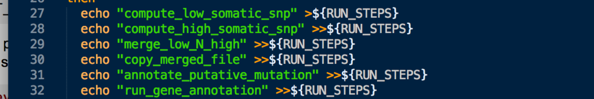
User Data Script, WinSCP, and OpenSSH
1
User Data Script
Launch instance using a Shell script. Pass user data as script. User data can be passed as an EC2 instance metadata.
WinSCP and OpenSSH
2
WinSCP is used for transfers, and OpenSSH is used in Linux or Mac for ssh connections.

Slide 7

EBS Volumes and Snapshots
Creating Volume
Attaching Snapshots
Create a volume and connect to the instance while launching, or attach as an additional volume later.
Create a snapshot of a volume to backup and restore.

Slide 8

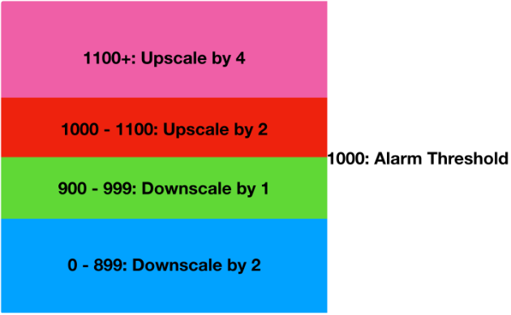
AMI and Autoscaling Groups
Creating Instance
Autoscaling Group
Launch instance using AMI.
Set up to scale EC2 instances in or out automatically based on defined conditions.

Slide 9
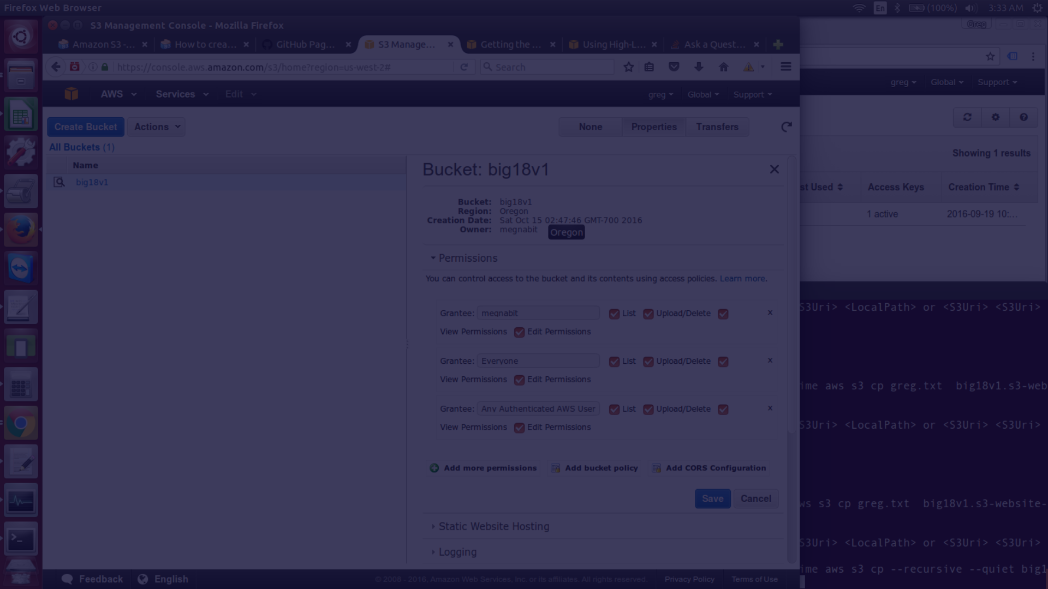
Introduction to S3
1
S3 Buckets
Create a bucket, upload files, and give permissions to set up the S3 bucket. Object ownership can be private or public.
Bucket Versioning
2
Versioning keeps multiple versions of an object in the same bucket.

Slide 10
S3 Static Website Hosting, Encryption, and Storage Classes
S3 Hosting
Encryption
Storage Classes
S3 allows static files in a bucket to be hosted. Use an S3 bucket as a web server with static website hosting.
S3 encrypts files using SSE-S3 or SSE-KMS to protect your data.
S3 has different storage classes, such as Amazon S3 Standard, Standard-Infrequent (IA) and Amazon S3 Glacier.

Slide 11
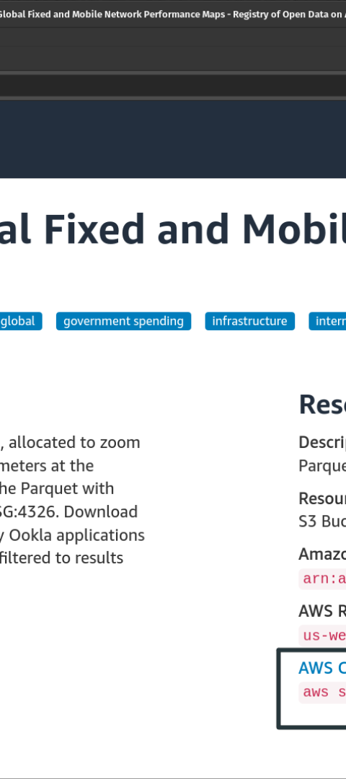
CLI and Cloudfront
Launch an instance
Launch EC2 instance, create an IAM user, and install the AWS CLI using the command prompt.
CloudFront
Content Delivery Network for Amazon Web Services. Cloudfront is used to serve cached content from the nearest datacenter from the user's location.

Slide 12
AWS Lambda
Lambda
AWS Iam
AWS Lambda allows you to run code without managing infrastructure, ideal for serverless services. Create a function and access permissions using IAM roles.
IAM provides enhanced security. Modify IAM roles to support managing user access to resources.

Slide 13


Amazon EFS and Amazon SSM
Amazon EFS
Amazon SSM
Use Amazon Elastic File System to create a distributed file system that can be used across multiple instances. Modify IAM roles supporting proper permissions.
Use Amazon Simple Systems Manager to manage your EC2 infrastructure at scale.

Slide 14
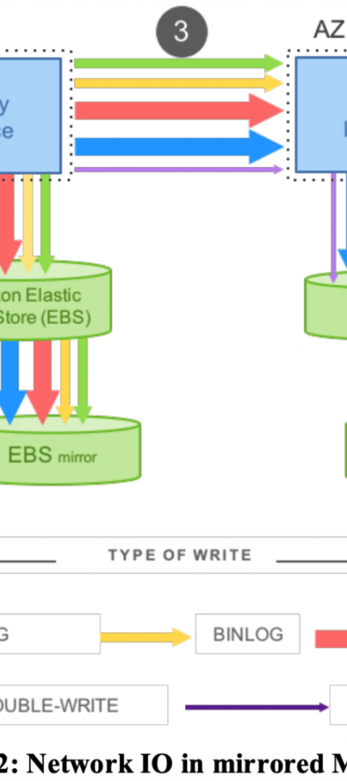
Amazon RDS
1
Downloading SQLyog
Start with downloading SQLyog from GitHub and setting enableRowSelect to true in order to select multiple rows.
2
Installing SQLyog
After downloading SQLyog, install and create the first database.

Slide 15

Route53 and AWS Trusted Advisor
Route53
Use Route53 to register a domain, create a hosted zone, and create a health check.
AWS Trusted Advisor
AWS Trusted Advisor provides optimization and cost control to AWS services by inspecting your AWS environment and providing recommendations when opportunities exist to reduce cost or improve system performance and reliability.

Slide 16

Interview Questions
What is the difference between an Aname record and a Cname record? An Aname record points a name to a specific IP, while Cname record points a name to another name.
Can we purchase AWS resources in advance? Yes, AWS offers reservation services such as AWS Reserved Instances (RIs) and Savings Plans where you can pre-reserve compute resources in advance to help lower costs.

